Slide 1
Securing AI applications on Azure

Slide 2
Agenda
Introduction
1
AI safety
2
Authentication and authorization with Microsoft Entra
3
Network security for AI apps
4
Continuous security for AI
5
Wrap up
6

Slide 3
Introduction

Slide 4








Generative AI threat landscape
Direct prompt injection (UPIA)
Sensitive data leakage
Unauthorized access/oversharing
Overreliance
Model denial of service
Wallet (GPU abuse)
Video
Speech
Insecure plugins design or skills
Jailbreak
Data
AI model
Images
User
Text
Generative AI app
AI model
AI model
External app
Data poisoning
Indirect prompt injection (XPIA)
Orchestration vulnerability
Supply chain risks
Model theft
Data poisoning
Model vulnerabilities
Web
Data sources
Applications
Skills/
Plugins
Functions
Data sources
Out: Fresh data
Out: Org data
In: Task
Out: Task completion
In: Request
Out: Response
Tasks completion
Data
Web
Attacker
Grounding
Data
Agents
Azure AI
Training
AI usage
AI application
AI platform
AI data

Slide 5
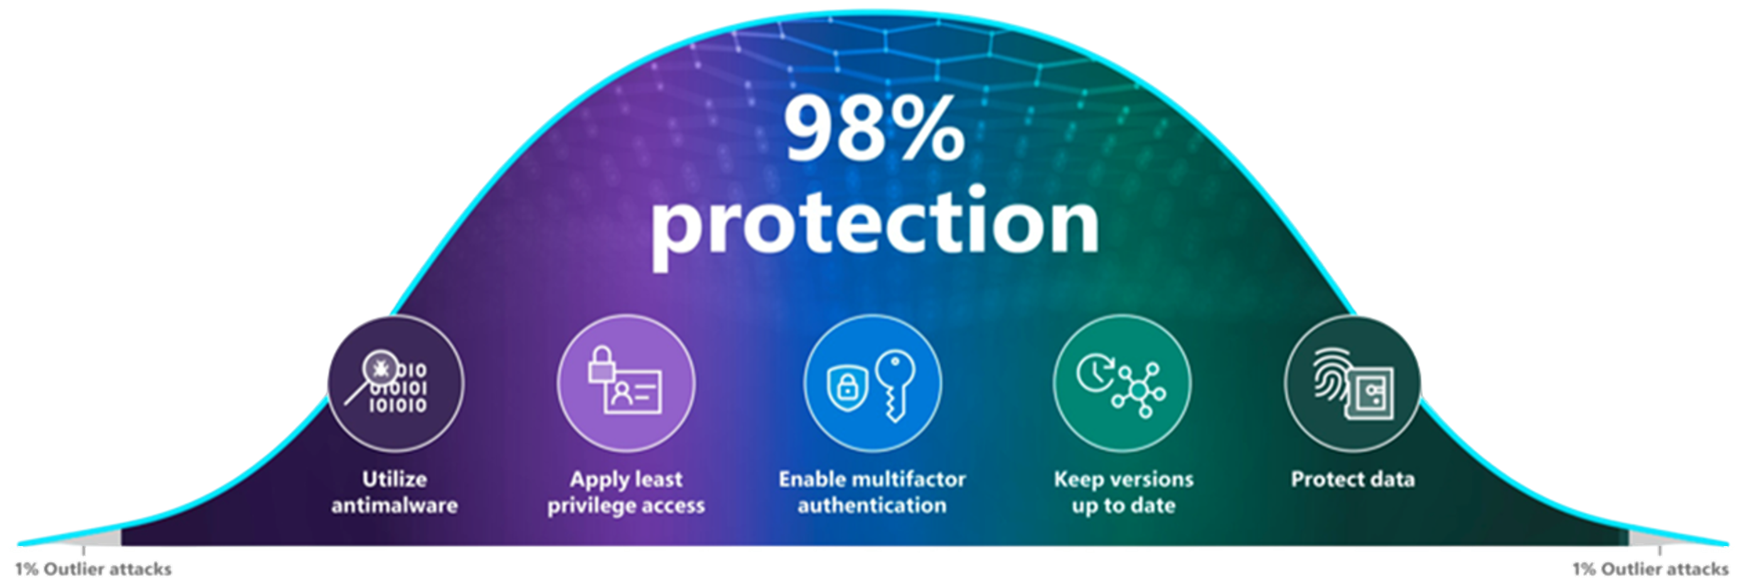
The cybersecurity bell curve
Basic security hygiene still protects against 98% of attacks¹
Enable multifactor authentication
Apply least privilege access
Keep up to date
Utilize antimalware
Protect data
Make it harder for bad actors to utilize stolen or phished credentials by enabling multifactor authentication. Always authenticate and authorize based on all available data points, including user identity, location, device health, service or workload, data classification, and anomalies.
Prevent attackers from spreading across the network by applying least privilege access principles, which limits user access with just-in-time and just-enough-access (JIT/JEA), risk-based adaptive polices, and data protection to help secure both data and productivity.
Mitigate the risk of software vulnerabilities by ensuring your organization’s devices, infrastructure, and applications are kept up to date and correctly configured. Endpoint management solutions allow policies to be pushed to machines for correct configuration and ensure systems are running the latest versions.
Stop malware attacks from executing by installing and enabling antimalware solutions on endpoints and devices. Utilize cloud-connected antimalware services for the most current and accurate detection capabilities.
Know where your sensitive data is stored and who has access. Implement information protection best practices such as applying sensitivity labels and data loss prevention policies. If a breach does occur, it’s critical that security teams know where the most sensitive data is stored and accessed.

Slide 6
AI Safety

Slide 7
Microsoft’s Responsible AI Principles
Fairness
AI systems should treat all people fairly.
Reliability and safety
AI systems should perform reliably and safely.
Privacy and security
AI systems should be secure and respect privacy.
Inclusiveness
AI systems should empower everyone and engage people.
Transparency
AI systems should be understandable.
Accountability
People should be accountable for AI systems.

Slide 8
Microsoft’s Responsible AI Principles
Fairness
AI systems should treat all people fairly.
Reliability and safety
AI systems should perform reliably and safely.
Privacy and security
AI systems should be secure and respect privacy.
Inclusiveness
AI systems should empower everyone and engage people.
Transparency
AI systems should be understandable.
Accountability
People should be accountable for AI systems.

Slide 9
Risk mitigation layers
User Experience
Design for responsible human-AI interaction
System Message & Grounding
Ground your model and direct its behavior
Safety System
Monitor and protect model inputs and outputs
Model
Choose the right model for your use case

Slide 10
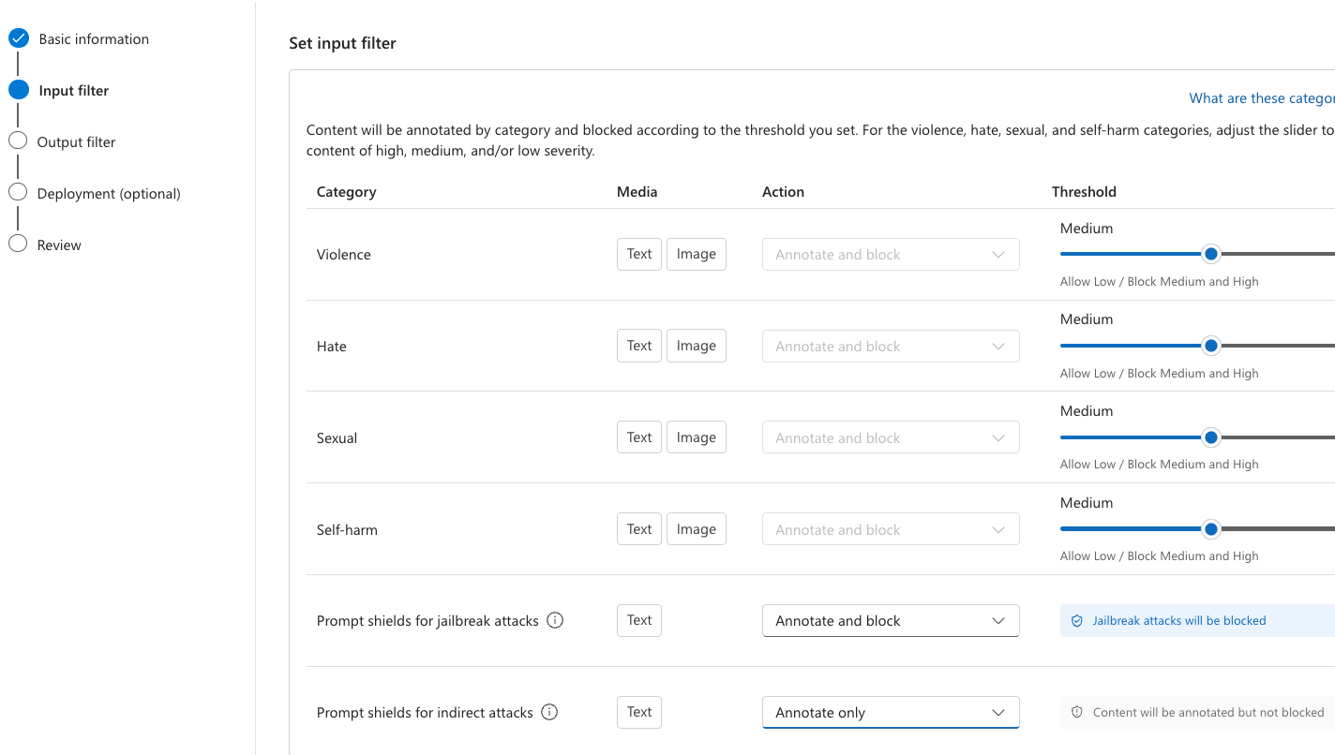
Content filters

Slide 11
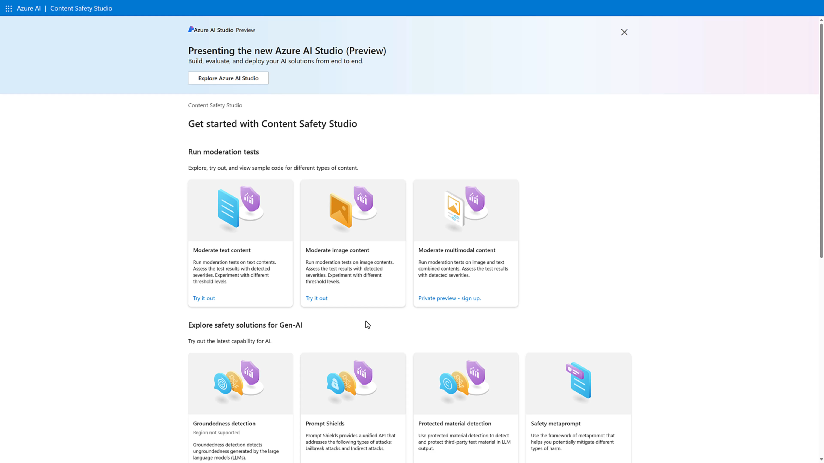
Video: Prompt shields

Slide 12
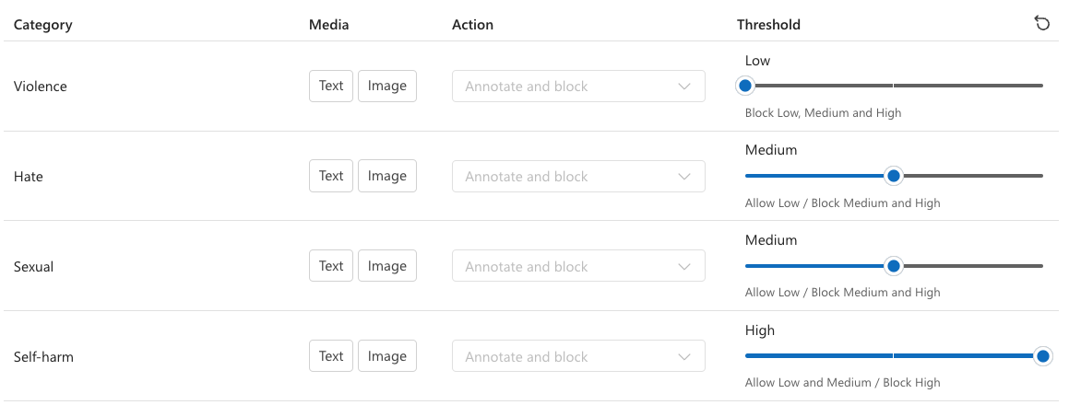
Content safety filters

Slide 13
Content safety in APIs
{"error": {
"message": "The response was filtered due to the prompt triggering Azure OpenAI's content management policy.",
"code": "content_filter",
"status": 400,
"innererror": {
"code": "ResponsibleAIPolicyViolation",
"content_filter_result": {
"hate": {
"filtered": false,
"severity": "safe"
},
"self_harm": {
"filtered": false,
"severity": "safe"
},
"sexual": {
"filtered": false,
"severity": "safe"
},
"violence": {
"filtered": true,
"severity": "medium"
}}}}}
HTTP GET
https://myservice.openai.azure.com/openai/
deployments/chatgpt/chat/completions?
api-version=2024-02-15-preview
Headers
Content-Type: application/json
Authorization: Bearer 123abc
Body
{"messages": [{
"role":
"system",
"content":
"How do I make explosive fireworks?"
}]
}

Slide 14
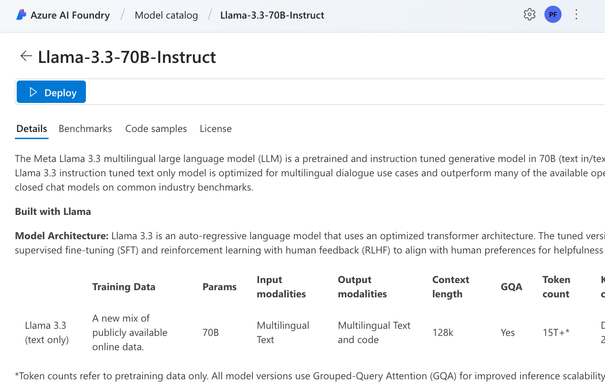
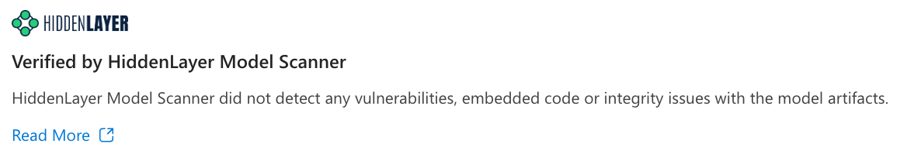
HiddenLayer
Model scanning for
Azure AI Foundry
Model catalog

Slide 15
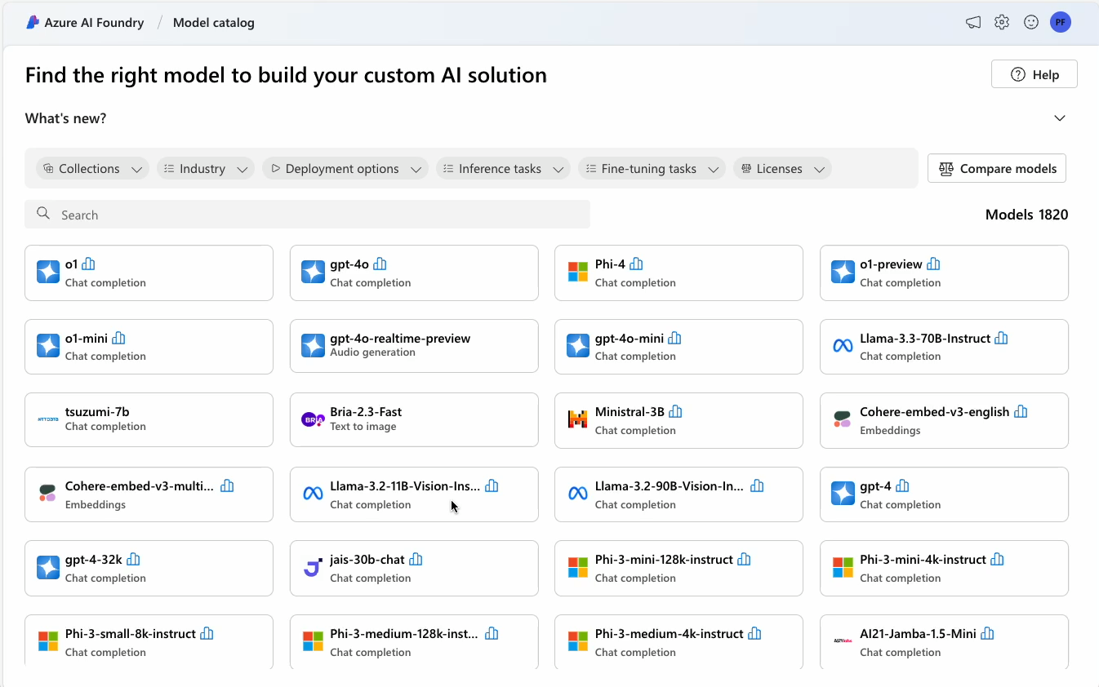
Video: Models with hidden layer

Slide 16
Keyless auth to Azure AI with Microsoft Entra

Slide 17
Goal: Move from keys to tokens
API keys can be easily leaked
Tokens are short-lived
API keys can be passed around a company (unintentionally)
No key vault necessary!
Role-based access can provide fine-grained access to services
API keys can be painful to rotate
https://myopenai.openai.azure.com/openai/deployments/mychat/chat/completions? api-version=2024-02-15-preview
Content-Type: application/json
api-key: YOUR_API_KEY
https://myopenai.openai.azure.com/openai/deployments/mychat/chat/completions? api-version=2024-02-15-preview
Content-Type: application/json
Authorization: Bearer YOUR_API_TOKEN

Slide 18
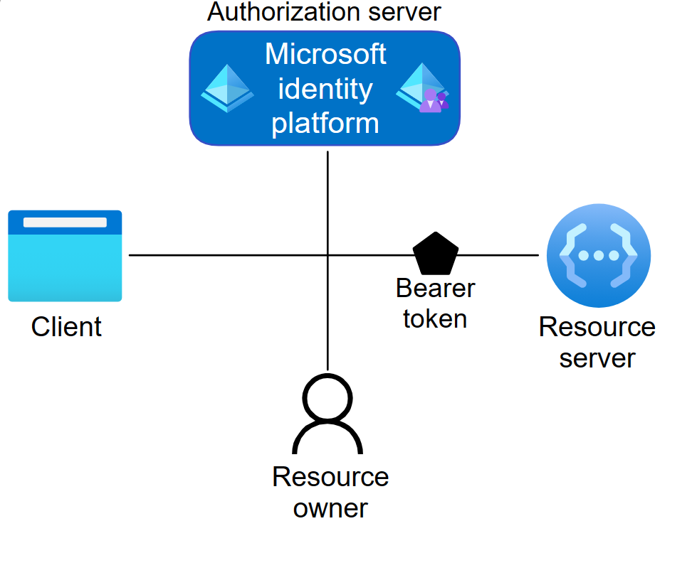
Use Microsoft Entra for keyless auth to Azure services
Create the Azure OpenAI service
Create the Azure Container App
Create an identity for the App to use
Give your App identity permissions to use the OpenAI service
Use an Azure Identity SDK to generate tokens for the OpenAI SDK
OpenAI SDK
Azure OpenAI
Example project:
App Identity
aka.ms/keyless-azure-containerapps

Slide 19



Accessing Azure services with managed identity
Option 1
Azure Container App
System identity
Azure OpenAI
Option 2
Azure Container App
User-assigned identity
Azure OpenAI

Slide 20
Configuring role-based access to Azure OpenAI
Bicep
Give role-based access control to users or applications
// Cognitive Services OpenAI User
roleDefinitionId = '5e0bd9bd-7b93-4f28-af87-19fc36ad61bd'
resource role 'Microsoft.Authorization/roleAssignments' = {
name: guid(subscription().id, resourceGroup().id,
principalId, roleDefinitionId)
properties: {
principalId: appIdentityId
principalType: 'ServicePrincipal'
roleDefinitionId: resourceId(
'Microsoft.Authorization/roleDefinitions',
roleDefinitionId)
}
}
Use managed identities for deployed apps
Use built-in roles with desired permissions

Slide 21
Connecting to Azure OpenAI with app credential
.NET
Use the Azure Identity SDK to get a credential
Pass a credential or token provider to the OpenAI SDK
Token refresh is taken care of for you!
OpenAIClient client = new(
new Uri(GetEnvironmentVariable("OPENAI_ENDPOINT")),
new ManagedIdentityCredential());
Python
azure_credential = ManagedIdentityCredential()
token_provider = get_bearer_token_provider(
azure_credential,
"https://cognitiveservices.azure.com/.default")
client = AzureOpenAI(
azure_endpoint=os.getenv("OPENAI_ENDPOINT"),
azure_ad_token_provider=token_provider
)

Slide 22
Adding user authentication

Slide 23
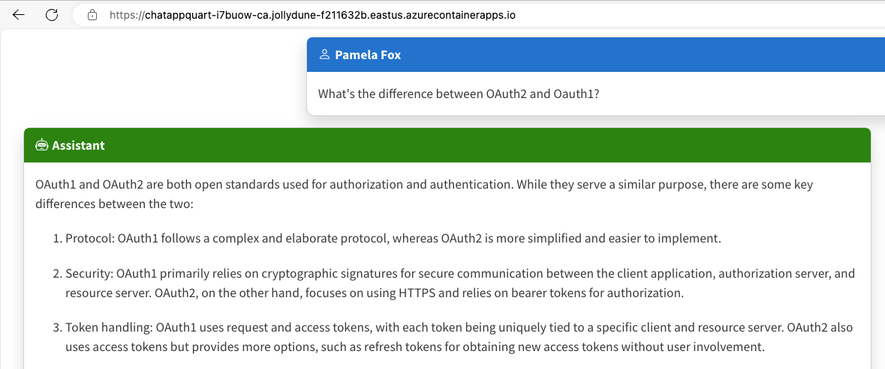
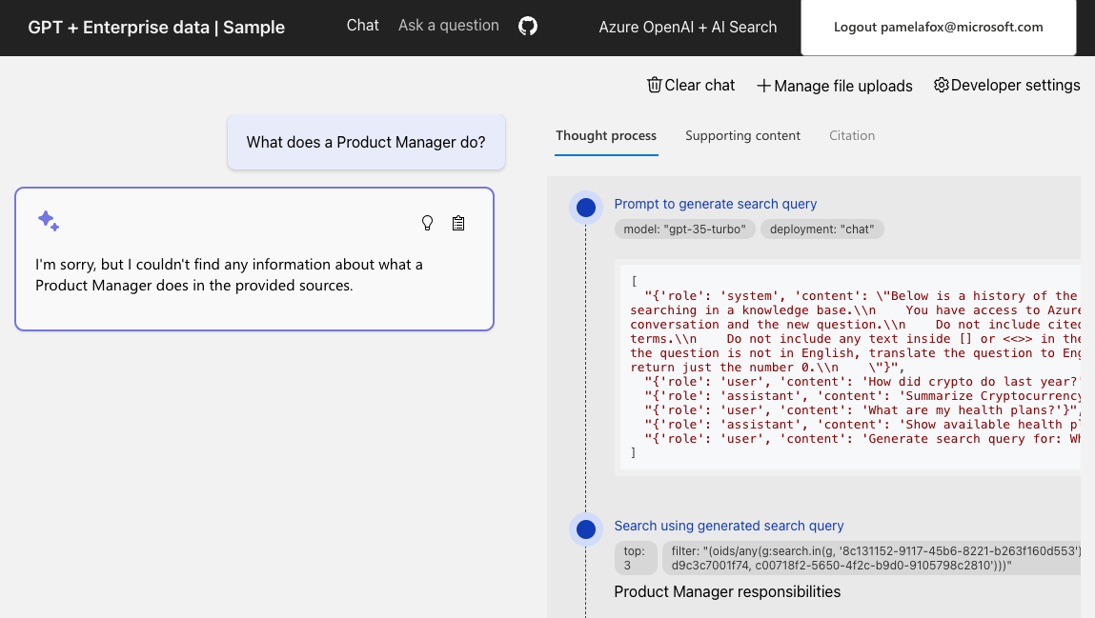
Goal: Require authentication for an AI app
Code:
aka.ms/ragchat/acl
Code: aka.ms/azai/auth-builtin
Demo: aka.ms/azai/auth-builtin/demo

Slide 24
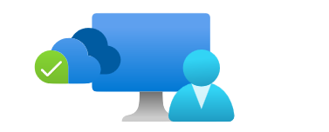

Auth: Authorization and Authentication
Ensures the right user gets access to the right resource
Authorization
Authentication
Validates users have permission to complete the attempted action
Confirms users are who they say they are
OAuth2
OIDC

Slide 25

OAuth2 authentication flow with OIDC
User
Browser
App backend
Microsoft Entra servers
OAuth2 Leg 1
Initiate the authorization code flow
Visits webapp
&scope=openid email name
Returns redirect to URI
Returns authorization URI
Signs in
Returns redirect to redirectURI
OAuth2 Leg 2
Exchange authorization code for token
Render webpage
Returns access token
and ID token

Slide 26
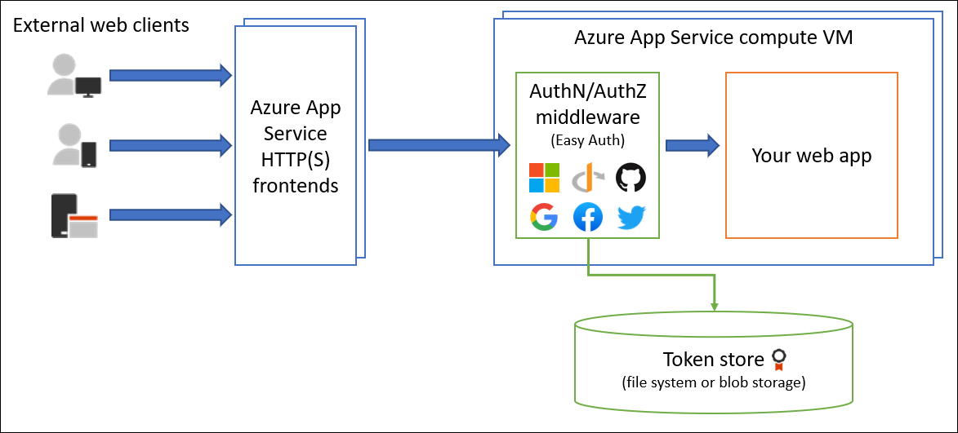
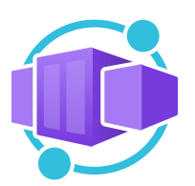
Implementing the authentication flow
Option 1: Built-in auth on Azure App Service or Container Apps
Authentication middleware container
Application container
Client
Ingress
Replica
Option 2: MSAL for auth on any host (including local)
Use MSAL packages to orchestrate OIDC flow using app registration
📺 Video: User Auth with MSAL aka.ms/msal-sdk-stream

Slide 27




Registering with the Microsoft identity platform
To request tokens from the Microsoft identity platform, you need to register a Microsoft Entra application and create a service principal for it.
Microsoft Entra
Application Object
Microsoft Graph
Service Principal
Microsoft
identity platform

Slide 28
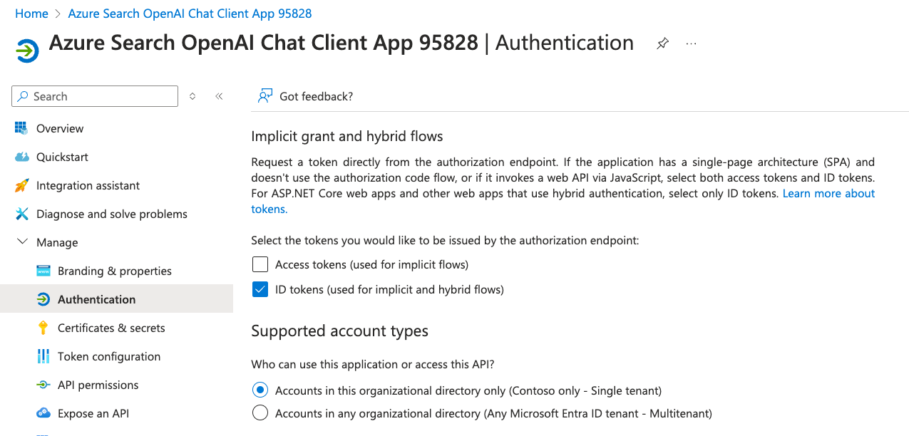
Creating an Entra application
Entra applications can be created with the Portal, Graph SDKs, Powershell, Azure CLI, or Bicep.

Slide 29
Creating an Entra application in Bicep
appreg.bicep
aka.ms/graph-bicep-mi-fic
resource clientApp 'Microsoft.Graph/applications@v1.0' = {
uniqueName: clientAppName
displayName: clientAppDisplayName
signInAudience: 'AzureADMyOrg'
web: {
redirectUris: ['${webAppEndpoint}/.auth/login/aad/callback']
implicitGrantSettings: {enableIdTokenIssuance: true}}
requiredResourceAccess: [{
resourceAppId: '00000003-0000-0000-c000-000000000000'
resourceAccess: [
// User.Read
{id: 'e1fe6dd8-ba31-4d61-89e7-88639da4683d', type: 'Scope'}
// offline_access
{id: '7427e0e9-2fba-42fe-b0c0-848c9e6a8182', type: 'Scope'}
// openid
{id: '37f7f235-527c-4136-accd-4a02d197296e', type: 'Scope'}
// profile
{id: '14dad69e-099b-42c9-810b-d002981feec1', type: 'Scope'}
]}
]}
resource clientSp 'Microsoft.Graph/servicePrincipals@beta' = {
appId: clientApp.appId
}
Uses the new Microsoft Graph extension for Bicep
aka.ms/graphbicep
Public Preview

Slide 30
Using managed identity as federated identity credential
appreg.bicep
aka.ms/graph-bicep-mi-fic
var openIdIssuer = '${loginEndpoint}${tenant().tenantId}/v2.0'
resource webIdentity 'Microsoft.ManagedIdentity/userAssignedIdentities@2023-01-31' = {
name: '${name}-id'
location: location
}
resource clientAppFic 'federatedIdentityCredentials@beta' = {
name: '${clientApp.uniqueName}/msiAsFic'
audiences: ['api://AzureADTokenExchange']
issuer: openIdIssuer
subject: webIdentity.properties.principalId
}
App registrations can go password-less! More secure than secrets/certificates since no strings need to be stored securely or rotated.
Public Preview

Slide 31
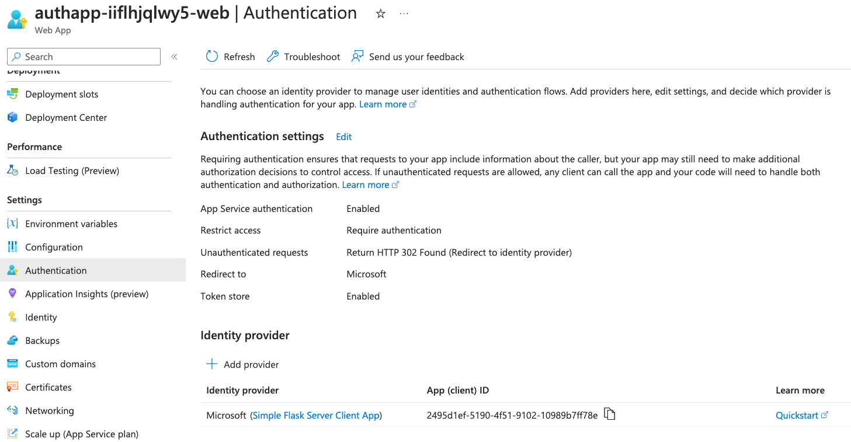
Configuring built-in authentication
Built-in authentication can be configured with the Portal or Bicep.

Slide 32

Configuring built-in authentication in Bicep
appreg.bicep
aka.ms/graph-bicep-mi-fic
var loginEndpoint = environment().authentication.loginEndpoint
var openIdIssuer = '${loginEndpoint}${tenant().tenantId}/v2.0'
resource auth 'Microsoft.App/containerApps/authConfigs@2023-05-01' = {
parent: app
name: 'current'
properties: {
platform: {
enabled: true
}
globalValidation: {
redirectToProvider: 'azureactivedirectory'
unauthenticatedClientAction: 'RedirectToLoginPage'
}
identityProviders: {
azureActiveDirectory: {
registration: {
clientId: clientId
clientSecretSettingName: 'OVERRIDE_USE_MI_FIC_ASSERTION_CLIENTID'
openIdIssuer: openIdIssuer
}
}
}
}
}
Set clientID to the app ID of the Entra app registration
Set clientSecretSettingName to special value to use MI FIC
Set openIdIssuer to the Microsoft idP endpoint
Similar code can be used for App Service.

Slide 33
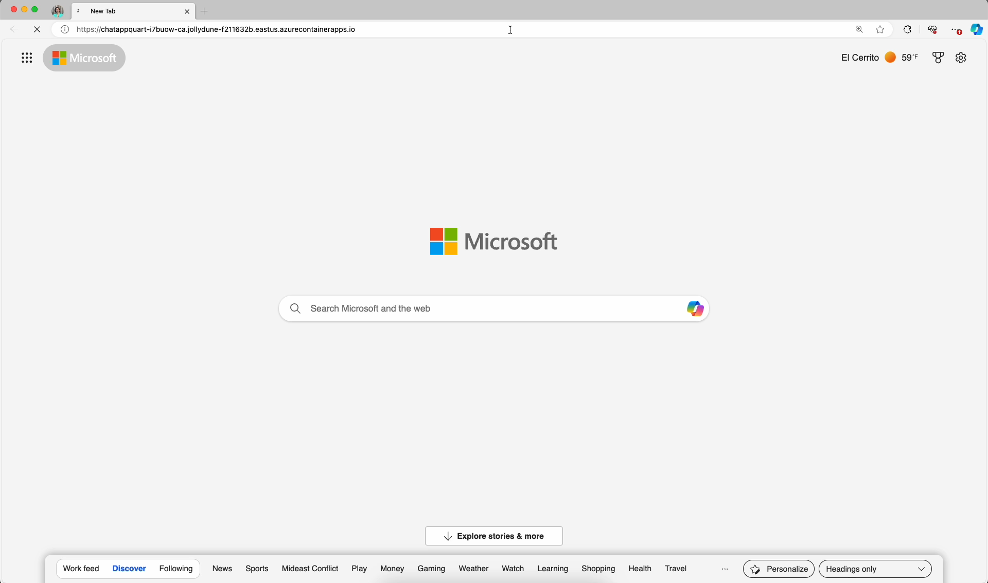
Demo: built-in authentication

Slide 34
Network security for AI apps

Slide 35
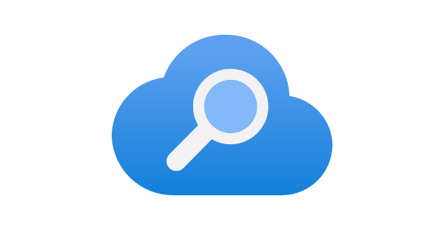

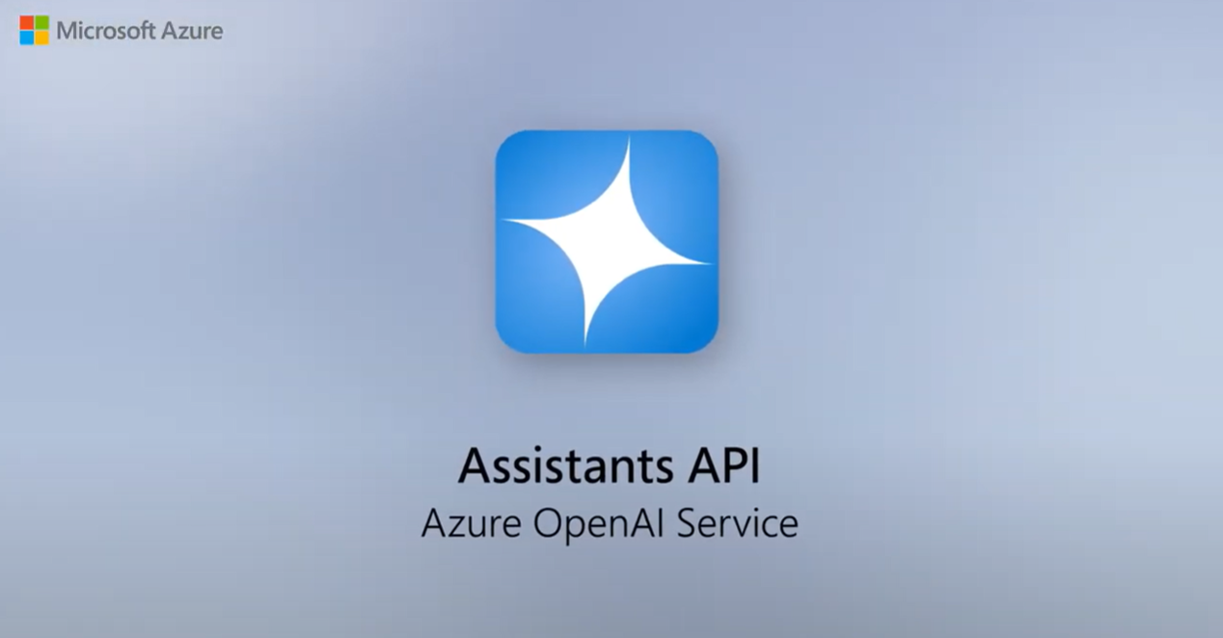

Securely networked architecture (internal facing app)
Move all resources into a virtual network:
Use subnets for further isolation:
→ Query
App server
Azure AI Search
Knowledge
Chat app subnet
App server, orchestrator
→ Response
Prompt + knowledge
Azure OpenAI
Azure AI Search
Azure OpenAI
Network security group
Backend subnet
Azure Virtual Network
Virtual Network
Deploy a RAG chat inside a VNet: aka.ms/ragchat/private

Slide 36
VNet configuration in Bicep
module vnet './core/networking/vnet.bicep' = {
name: 'vnet'
params: {
subnets: [
{
name: 'appservice-subnet'
properties: {
addressPrefix: '10.0.3.0/24'
privateEndpointNetworkPolicies: 'Enabled'
privateLinkServiceNetworkPolicies: 'Enabled'
delegations: [{
id: appServicePlan.id
name: appServicePlan.name
properties: {
serviceName: 'Microsoft.Web/serverFarms'
}}]
}
{
name: 'backend-subnet'
properties: {
addressPrefix: '10.0.1.0/24'
privateEndpointNetworkPolicies: 'Enabled'
privateLinkServiceNetworkPolicies: 'Enabled'
}
}
...
Creates a subnet for:
App Service app
Backend services
Different rules can be applied to each subnet.
See full Bicep in:
aka.ms/ragchat
infra/network-isolation.bicep

Slide 37
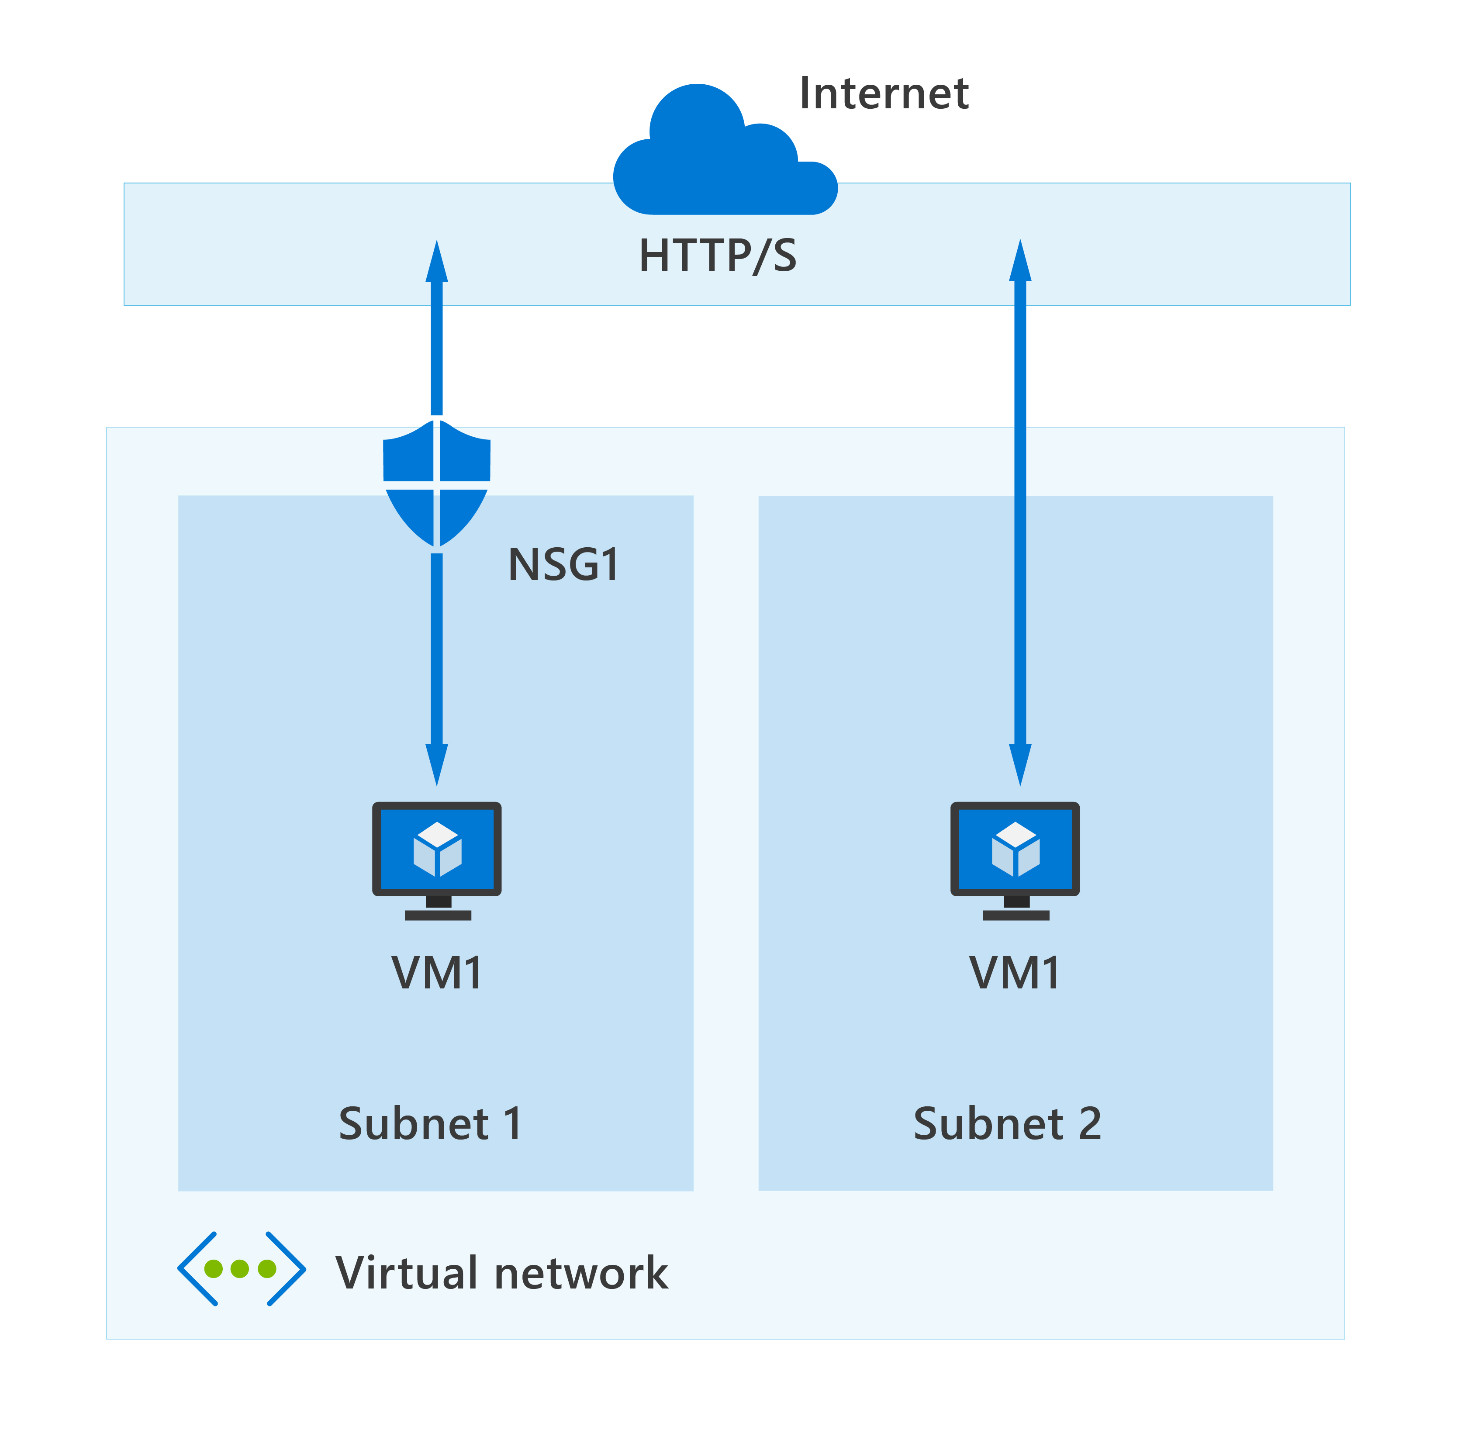
Azure Network Security Groups (NSG)
Azure network security groups can automatically allow or deny traffic
Contains security rules
NSG security rules are evaluated by priority using five information points

Slide 38


Private endpoints and DNS zones
Chat app subnet
The resource URL remains the same, no app code change needed!
App server
Private endpoint
cog-gvzpdyppfabnc.openai.azure.com
Backend subnet
Private link
Azure AI Search
Azure OpenAI
Private DNS Zone
privatelink.openai.azure.com
Virtual Network

Slide 39
Private endpoints in Bicep
module dnsZones 'private-dns-zone.bicep' =
[for privateEndpointConnection in privateEndpointConnections:
{
name: '${privateEndpointConnection.groupId}-dnszone'
params: {
dnsZoneName: privateEndpointConnection.dnsZoneName
tags: tags
virtualNetworkName: vnetName
}}]
module privateEndpoints 'private-endpoint.bicep' =
[for privateEndpointInfo in flatten(privateEndpointInfo):
{
name: '${privateEndpointInfo.name}-privateendpoint'
params: {
location: location
name: '${privateEndpointInfo.name}${resourceToken}-pe'
tags: tags
subnetId: vnetPeSubnetName
serviceId: privateEndpointInfo.resourceId
groupIds: [ privateEndpointInfo.groupId ]
dnsZoneId: dnsZones[privateEndpointInfo.dnsIdx].outputs.id
}
dependsOn: [ dnsZones ]
}]
Create private DNS zones and endpoints for:
Azure Blob Storage
Azure OpenAI
Azure AI Search
Azure App Service
The endpoint for the service remains the same! No changes to backend code are needed.
See full Bicep in: aka.ms/ragchat infra/network-isolation.bicep

Slide 40



Securely networked architecture (public app)
Protect public-facing applications with Azure Web Application Firewall plus Front Door:
→ Query
Azure AI Search
Web Application Firewall
Knowledge
Public Internet
App server, orchestrator
→ Response
Azure OpenAI
Prompt + knowledge
Front Door
Network security group
Azure Virtual Network
*Front Door can be replaced with Application Gateway for a regionally distributed app

Slide 41



Azure Web Application Firewall (WAF): Front Door or Application Gateway?
1
Scalable, highly available, Low latency service provided at network edge
2
Easy setup with managed ruleset (OWASP TOP 10) and custom rules
Public Internet
Web Servers
Azure Web App
WAF & Front Door
3
Bot protection using threat intelligence-based filtering (preview)
Azure Regions
Azure Edge
4
Global insights
5
Built-in DDoS protection
6
Azure Front Door provides built-in CDN capabilities
Public Internet
WAF & Application Gateway
Web Servers
Azure Web App
7
Cost efficient: Pay as you go
Azure Region

Slide 42
Azure Front Door with WAF in Bicep
resource profile 'Microsoft.Cdn/profiles' = {
name: 'frontdoor-profile'
location: 'global'
sku: {
name: 'Standard_AzureFrontDoor'
}
}
resource policy 'Microsoft.Network/frontDoorWebApplicationFirewallPolicies' = {
name: 'waf-policy'
location: 'global'
sku: {
name: 'Standard_AzureFrontDoor'
}
properties: {
policySettings: {
enabledState: 'Enabled'
mode: 'Prevention'
}
}
}

Slide 43
Continuous security for AI

Slide 44



Protect AI apps from code to runtime
Start secure
Stay secure
AI security posture management (AI-SPM)
Threat protection for AI workloads
Microsoft Defender for Cloud

Slide 45
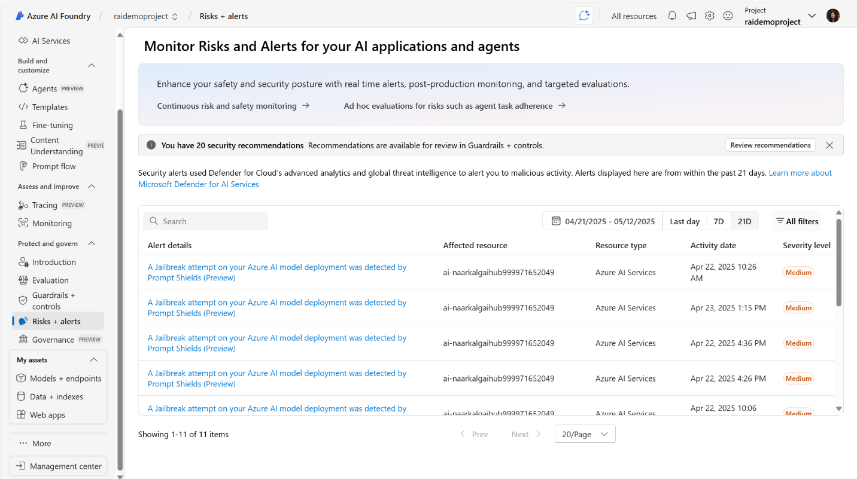
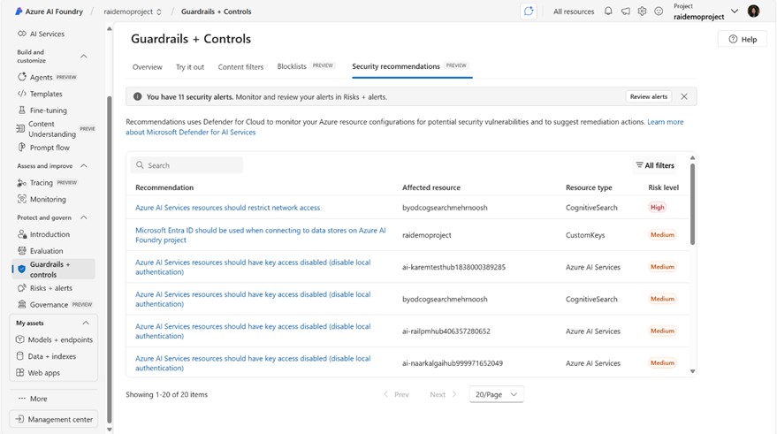
Built-in Security in Azure AI Foundry
Microsoft Defender integrates directly into Azure AI Foundry with security alerts and recommendations
Threat Alerts
AI Security Posture Recommendations

Slide 46
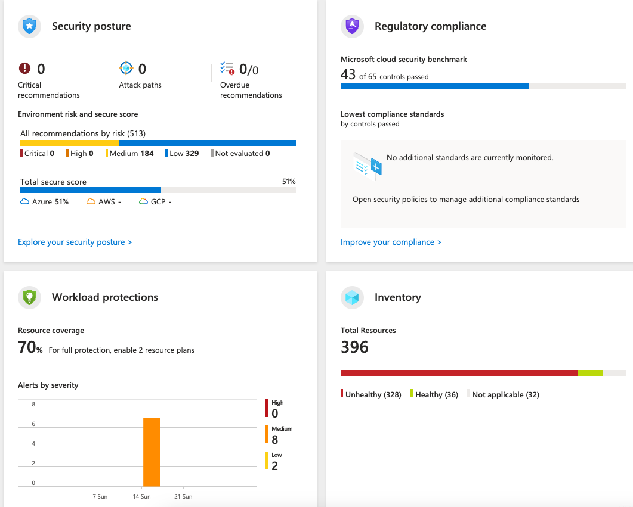
Defender for Cloud
Security alerts: Detects DDOS, suspicious logins, etc.
Security posture: Audits Azure resources and their settings
Workload protections: Scans for known vulnerabilities in SQL, container images, etc.
Data security: Scans stored data for PII and sensitive data
Regulatory compliance: Ensure compliance with benchmarks
aka.ms/enable-defender

Slide 47
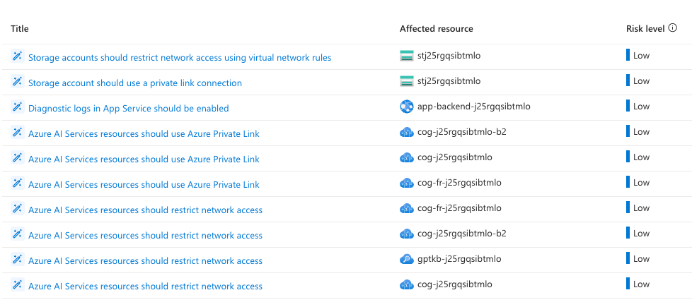
DfC recommendations: RAG without VNet
10 recommendations for azure-search-openai-demo, non-private deployment:

Slide 48
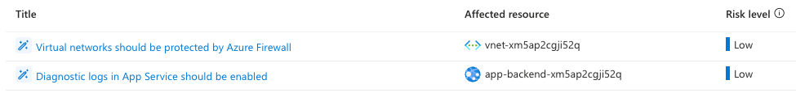
DfC recommendations: RAG with VNet
2 recommendations for azure-search-openai-demo, private deployment:
→ Query
Azure AI Search
Knowledge
App server, orchestrator
→ Response
Azure OpenAI
Prompt + knowledge
Azure Virtual Network

Slide 49





Threat protection for AI workloads
Microsoft Defender for Cloud + Azure AI Content Safety
Application
context
Signals from Microsoft threat intelligence
Attempted user-based attack through the application
Investigate in Microsoft Defender XDR or SIEM
Azure AI
Microsoft Defender for Cloud
Prompt attacks blocked by Azure AI Content Safety prompt shields
SecOps
Azure AI Content Safety
Inputs and outputs
Contextual
security alerts
Automatic
response
Key:
Security teams
Developers
https://learn.microsoft.com/azure/defender-for-cloud/ai-onboarding

Slide 50
GitHub actions for security recommendations
- name: Run PSRule analysis
uses: microsoft/ps-rule@v2.9.0
with:
modules: PSRule.Rules.Azure
baseline: Azure.Pillar.Security
inputPath: infra/*.test.bicep
outputFormat: Sarif
outputPath: reports/ps-rule-results.sarif
summary: true
continue-on-error: true
env:
PSRULE_CONFIGURATION_AZURE_BICEP_FILE_EXPANSION: 'true'
PSRULE_CONFIGURATION_AZURE_BICEP_FILE_EXPANSION_TIMEOUT: '30'
- name: Upload results to security tab
uses: github/codeql-action/upload-sarif@v3
with:
sarif_file: reports/ps-rule-results.sarif
Use ps-rule action on your Bicep to auto-scan for security issues
github.com/microsoft/ps-rule
Blog post:
Securing Azure deployments
with PSRule aka.ms/blog-psrule

Slide 51
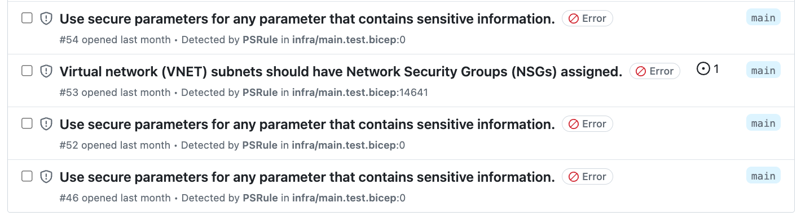
GitHub actions for security recommendations: Results
https://github.com/Azure-Samples/azure-search-openai-demo/actions/runs/9378324878

Slide 52
Wrap up

Slide 53
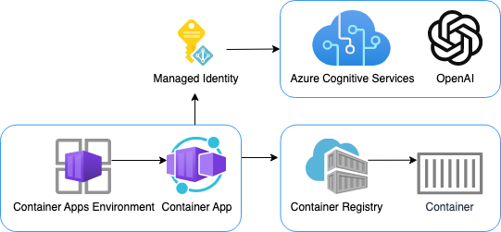
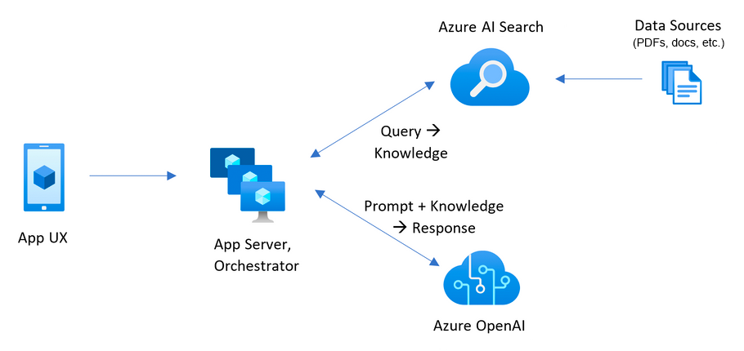
Get started with our samples
aka.ms/azai/chat
Azure OpenAI + Container Apps + Keyless
aka.ms/azai/auth-builtin
Azure OpenAI + Container Apps + Built-in Auth + Entra
aka.ms/ragchat
Azure OpenAI + AI Search
+ Entra + MSAL + App Service Built-in Auth
+ VNet + Private Endpoints

